Slide 1

E-Commerce App
Android Based

Slide 2




@software developer
Athar Ibrahim Khlaid
aikpak24@gmail.com

Slide 3
Objectives
An impactful e-commerce solution is vital in today's digital economy. We propose an Android-based application for the cosmetics sector, featuring a robust MySQL database for reliable data management. It offers fast filters, strong security, user-friendly features, and effective analytics, ensuring a seamless and secure shopping experience.

Slide 4


Components

Slide 5
UI
The UI component encompasses all elements visible to the user, including product listings (Images, name, Price, Description, Rating), filters products, shopping cart, user profile, favorite activity, edit profile, logout or delete account, verify gmail, verify phone_number and checkout screens.
It provides an intuitive and user-friendly interface for filtering products, managing purchases, updating user information and many more.

Slide 6
Backend
This component serves as the logic and data processing layer of the application.
It handles user requests, interacts with the database, performs business logic (such as order processing and inventory management), and generates responses to be displayed on the UI.

Slide 7
MySQL
The MySQL database serves as the central repository for storing product information, user profiles, order details, and other essential data.It handles user requests, interacts with the database, performs business logic (such as order processing and inventory management), and generates responses to be displayed on the UI.
It ensures persistent data storage, efficient retrieval of information, and supports transactions for order processing and user interactions.

Slide 8
API
The API layer acts as a bridge between the frontend (UI) and backend (database and application logic). I am trying to use API in my app that make URL around my data_connection with my xampp connections as PHP file and communicate with each other then my API store my data on my database, if found any error then that error is shown by my PHP script, that make it easy to store exact data.
It exposes endpoints for the UI to communicate with the backend, allowing for data retrieval, updates, and other operations. APIs handle requests from the UI and return appropriate responses, ensuring smooth interaction between components.

Slide 9
Auth
This component ensures the security of user data and authentication processes.
It implements measures such as data encryption during transmission, user authentication using MYSQL or other secure methods, and access control to protect sensitive information and user accounts.

Slide 10

Its time for some animations and trying to explain user interface
Splash Screen
Splash screen just end after 2.5 seconds.

Slide 11
Splash Screen
Splash screen just end after 2.5 seconds.

Slide 12
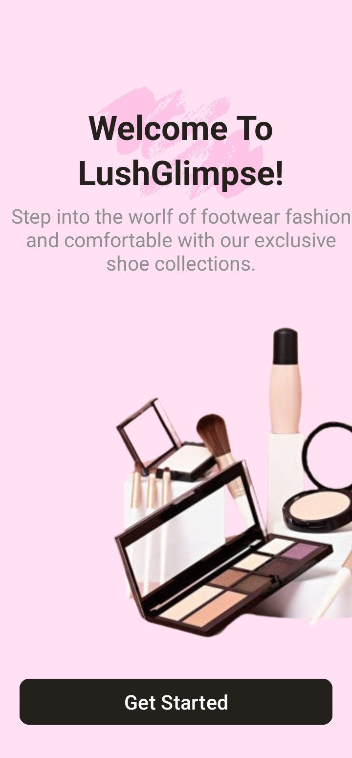
One Time Display
This activity just display one time when user not registered, skip it by just pressing Get Started button
Splash Screen
Splash screen just end after 2.5 seconds.

Slide 13
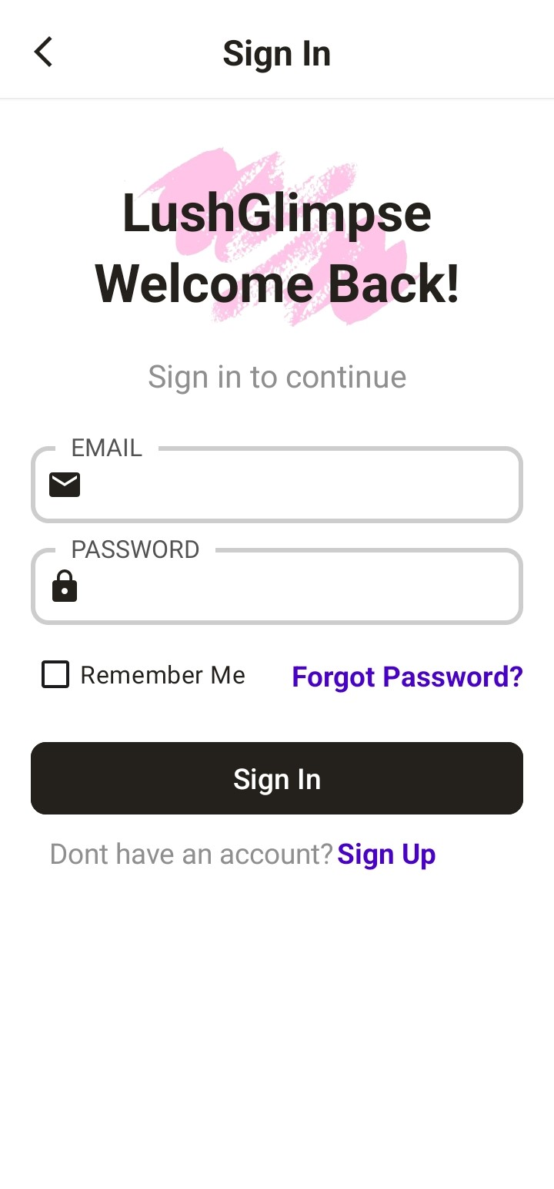
One Time Display
This activity just display one time when user not registered, skip it by just pressing Get Started button
Sign In
User login their account by using registered email and password.
Also have a feature of forgot password.

Slide 14
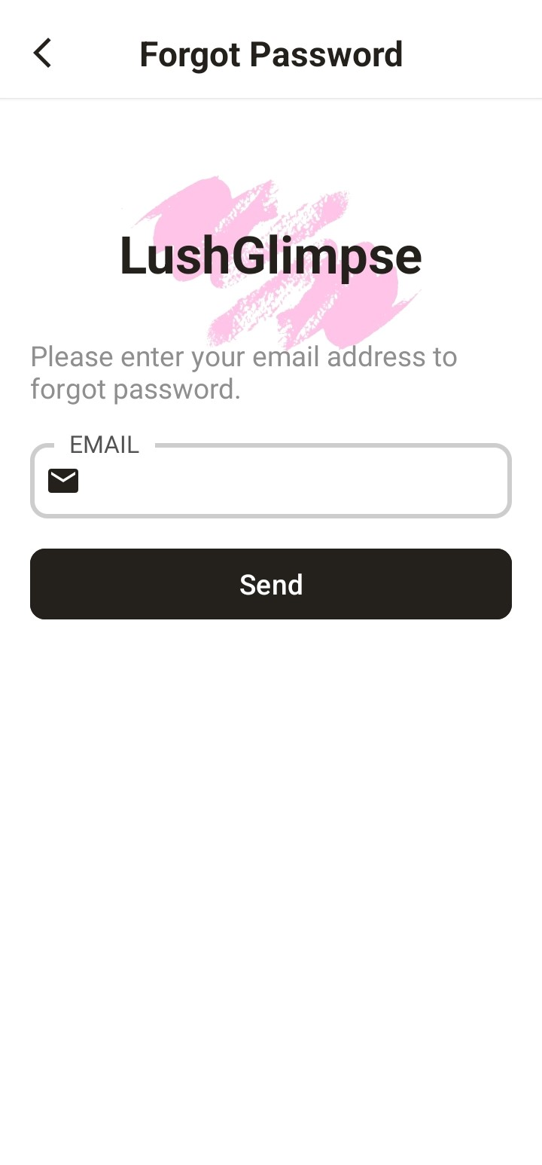
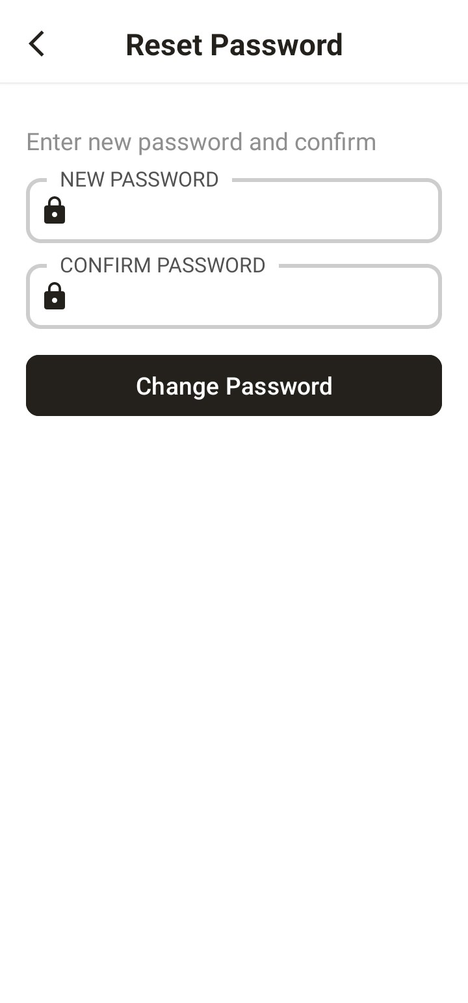
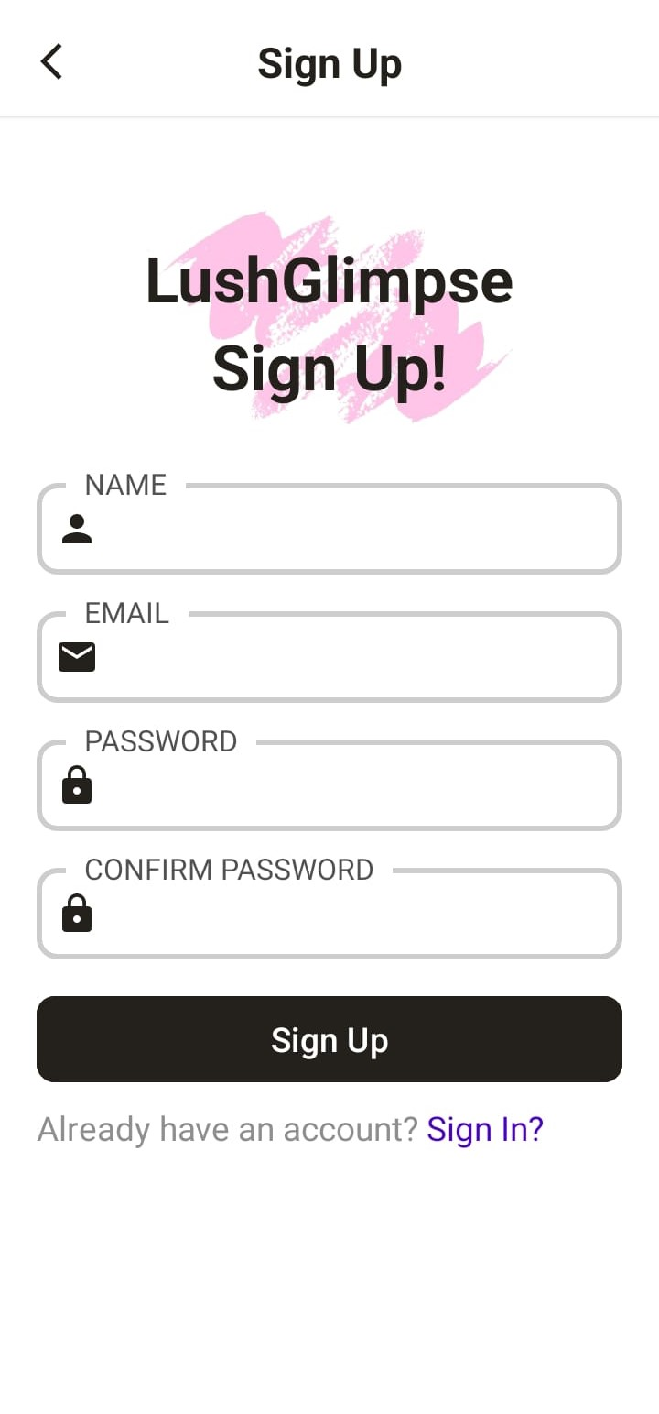
Sign In
User login their account by using registered email and password.
Also have a feature of forgot password.
Forgot Password
These activities required Email, if user exist then activity change to change password activity, otherwise, its show error.

Slide 15
Sign Up
User registered their new account by placing these following things, Name, Email(exact format otherwise, error display), also have a feature of strong password.
Forgot Password
These activities required Email, if user exist then activity change to change password activity, otherwise, its show error.

Slide 16
Forgot Password
These activities required Email, if user exist then activity change to change password activity, otherwise, its show error.

Slide 17
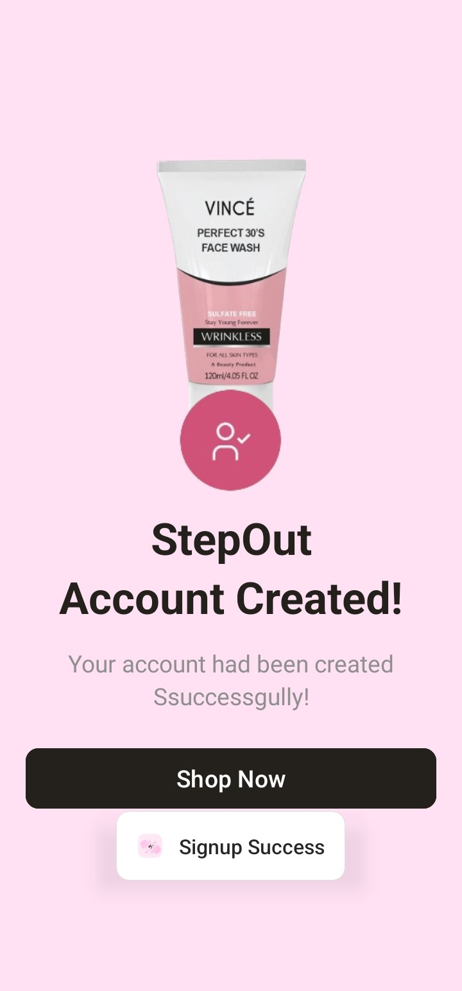
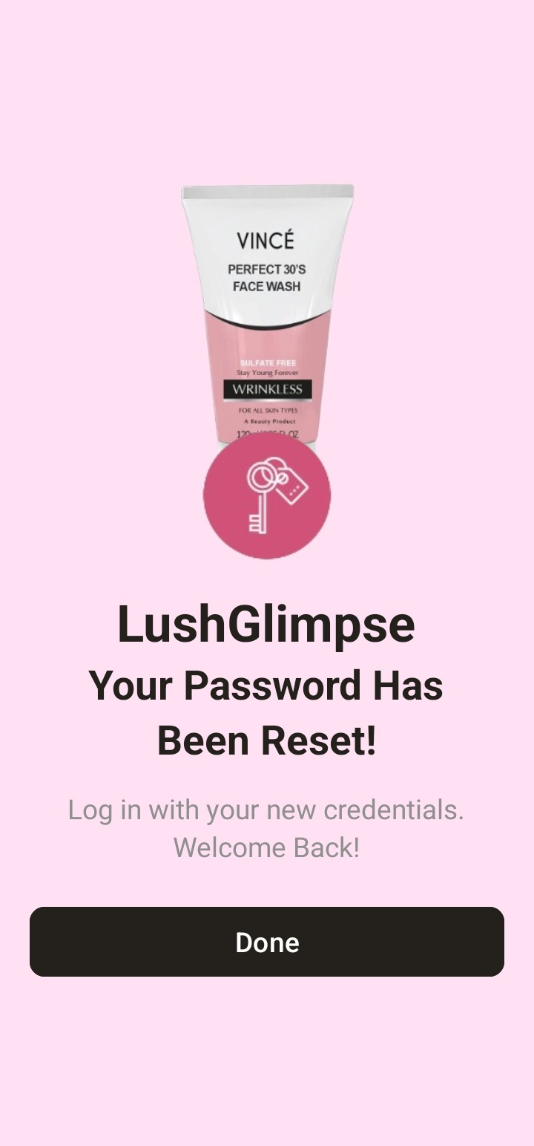
Change Password
This activity also have a feature of strong password otherwise, show errors.

Slide 18
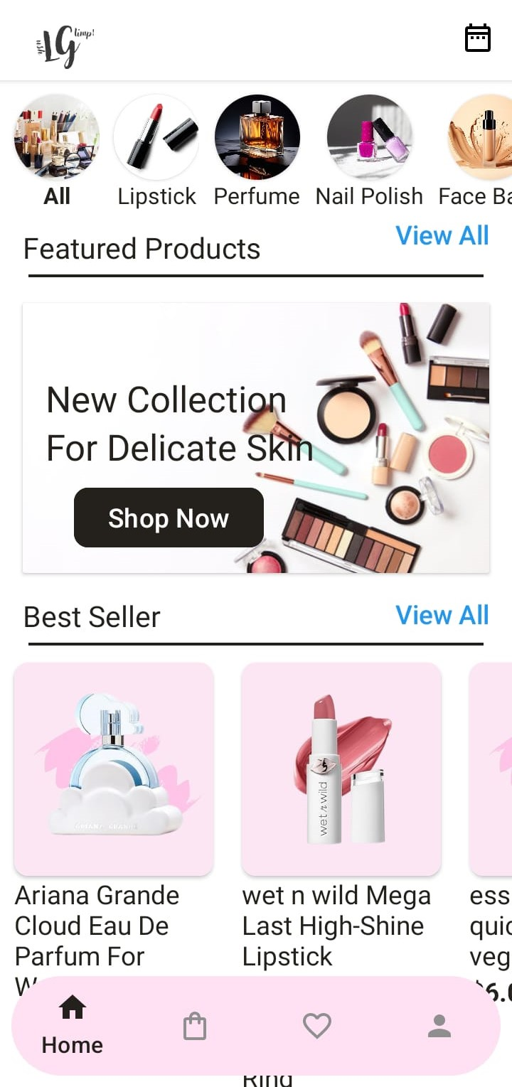
Main Screen
This screen show you all the listed items in the database.
The above filters are used to categorized the products.

Slide 19
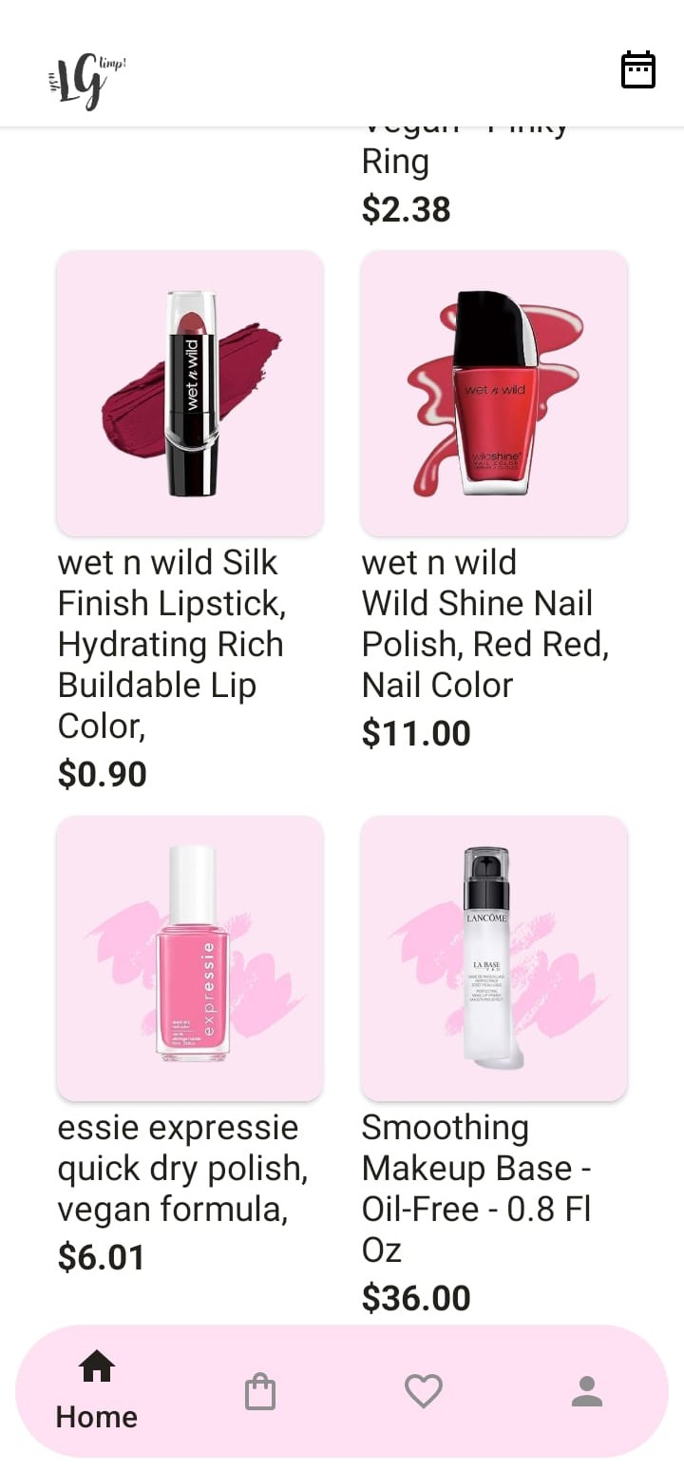
Main Screen
This screen show you all the listed items in the database.
The above filters are used to categorized the products.

Slide 20
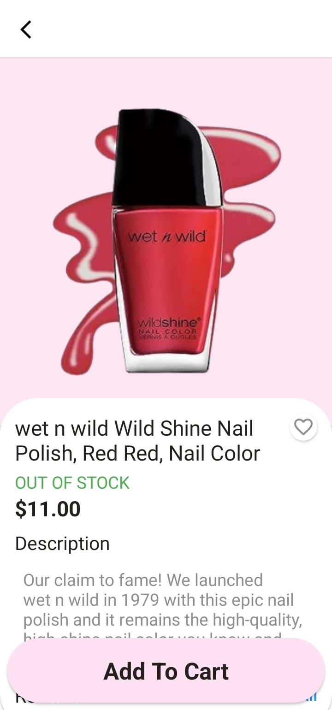
Product Details
When we click any product on main activity then this product details activity play.
This activity show details about product also have a feature of add to favorite and add to cart.
Main Screen
This screen show you all the listed items in the database.
The above filters are used to categorized the products.

Slide 21
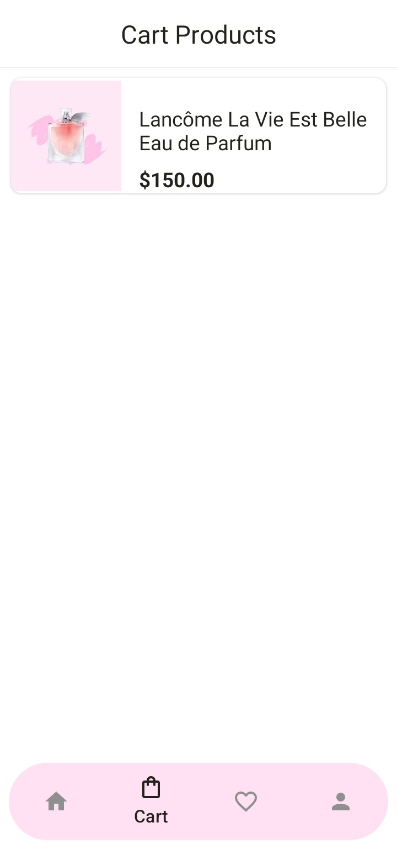
Product Details
When we click any product on main activity then this product details activity play.
This activity show details about product also have a feature of add to favorite and add to cart.
Cart Products
This activity/fragment display only that products which are added in the user cart.

Slide 22
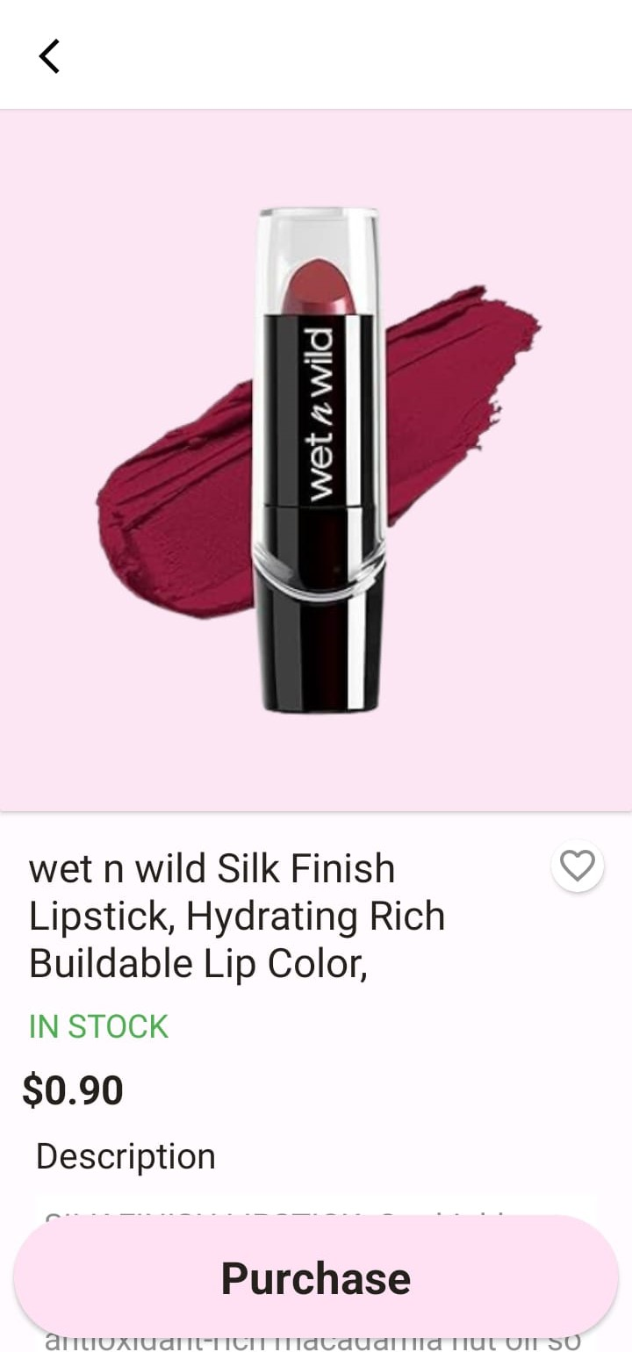
Purchase Cart
In this activity we purchased our cart product by just clicking on “Purchase” Button.
Cart Products
This activity/fragment display only that products which are added in the user cart.

Slide 23
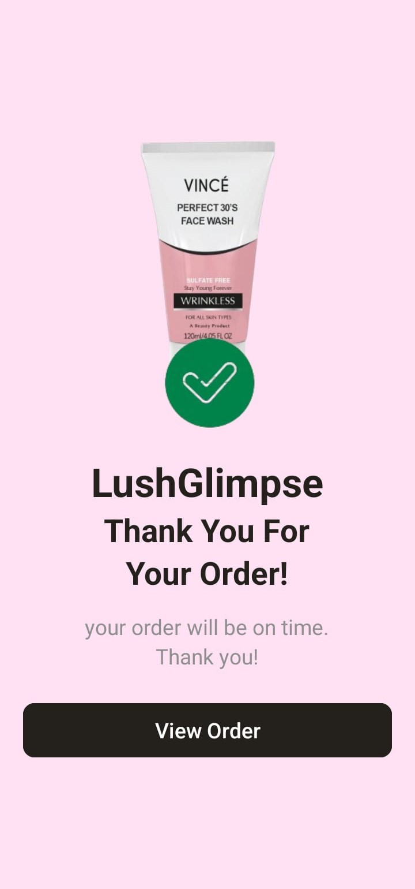
Purchase Cart
In this activity we purchased our cart product by just clicking on “Purchase” Button.

Slide 24
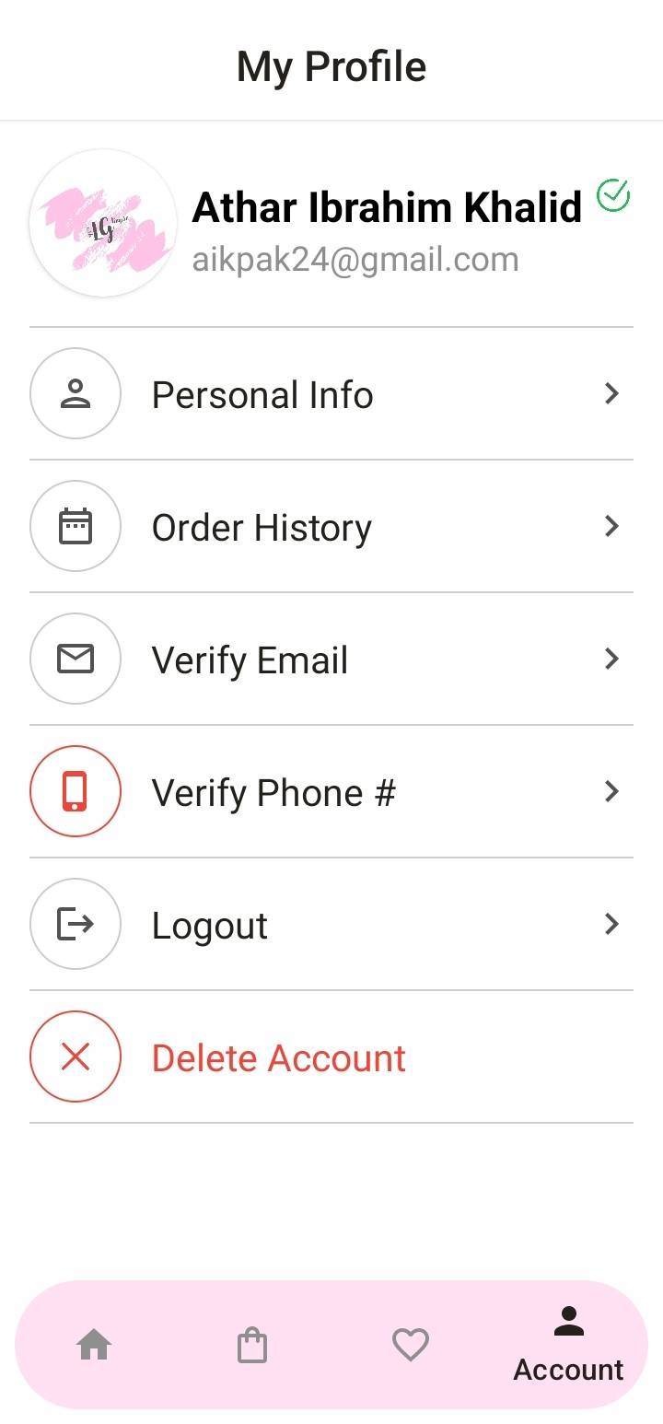

Slide 25
User Details
This fragment also integrate on main activity that help to shows user data and also have many options like edit account, see their orders, verify their email, verify their phone_number (verification is use such a great concepts), also use logout and delete account system.

Slide 26
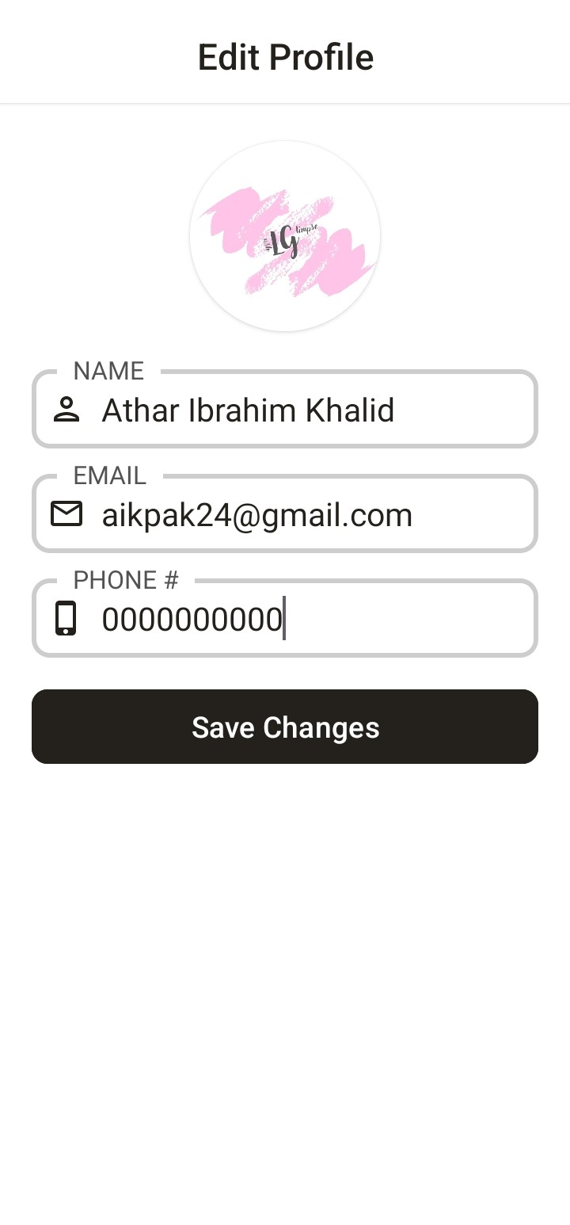
User Details
This fragment also integrate on main activity that help to shows user data and also have many options like edit account, see their orders, verify their email, verify their phone_number (verification is use such a great concepts), also use logout and delete account system.
Edit Profile
User edit their profile name and phone_number
Edit Profile
User edit their profile

Slide 27
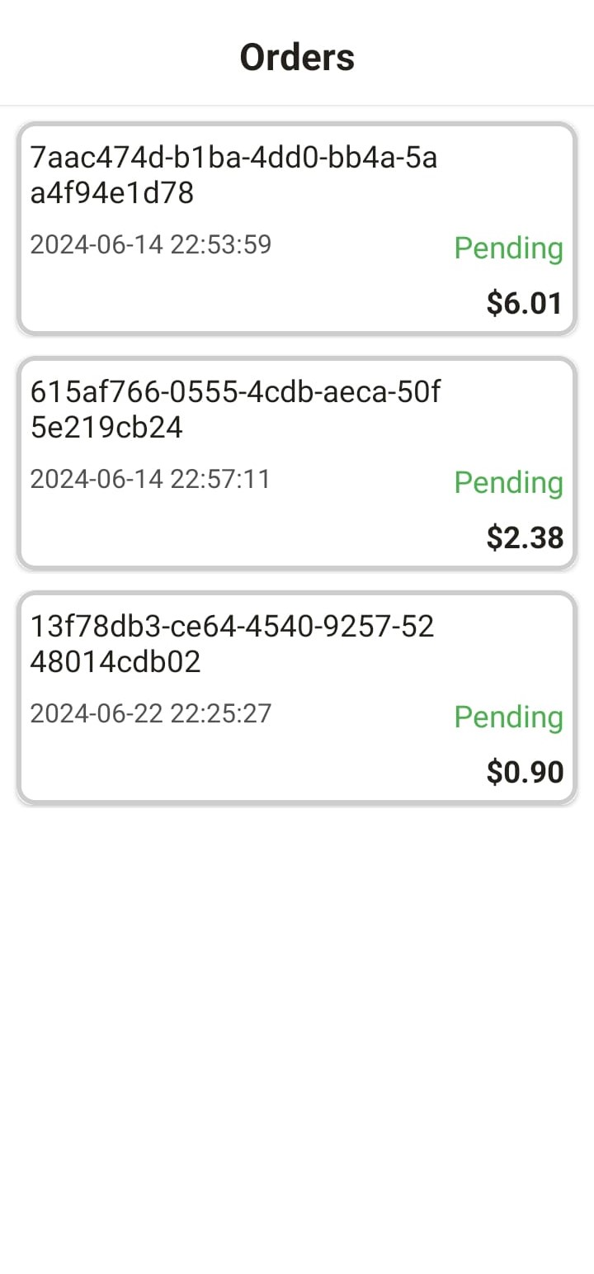
User Details
This fragment also integrate on main activity that help to shows user data and also have many options like edit account, see their orders, verify their email, verify their phone_number (verification is use such a great concepts), also use logout and delete account system.
Edit Profile
User edit their profile name and phone_number
Order History
Users see their order history on real time.

Slide 28
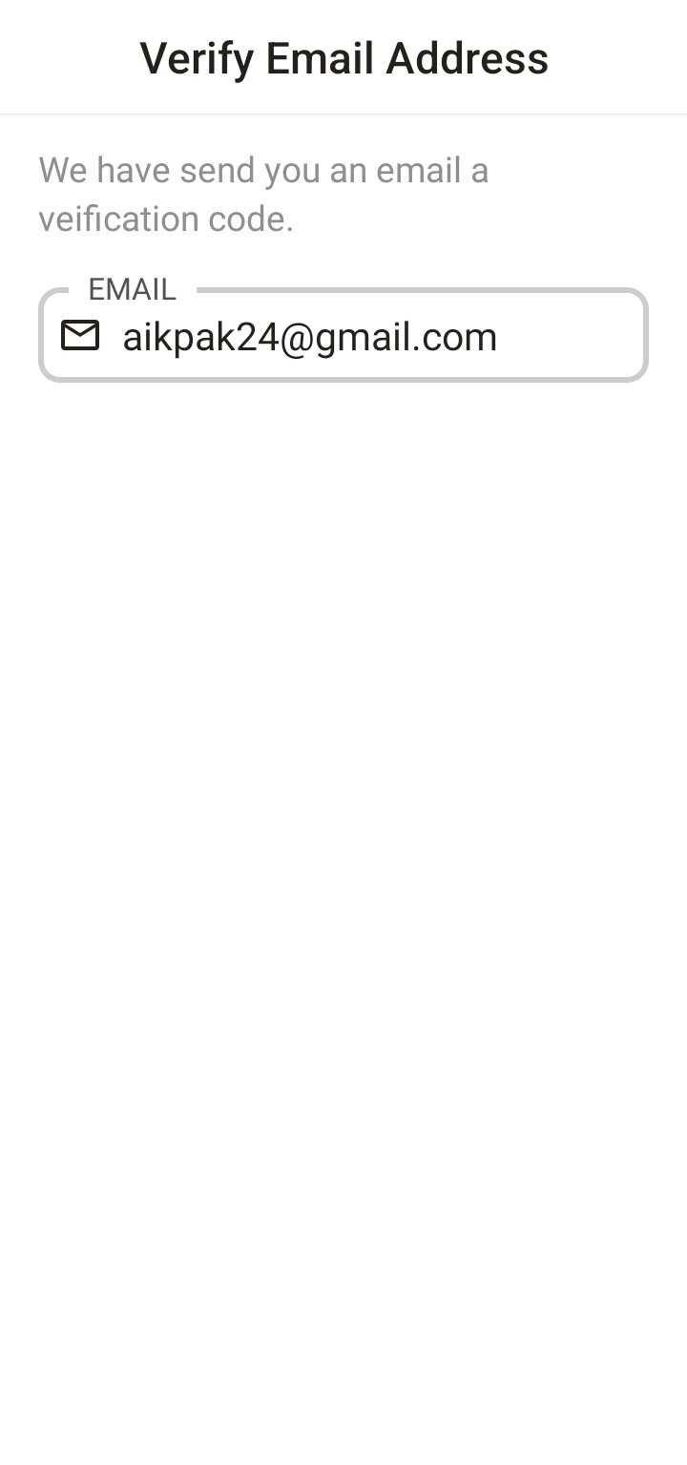
Order History
Users see their order history on real time.
Verify Email
Verify user email by otp that display on app for 3 seconds, if user enter wrong otp then their account block for 24hours
Edit Profile
User edit their profile
Verify Email
Verify user email

Slide 29
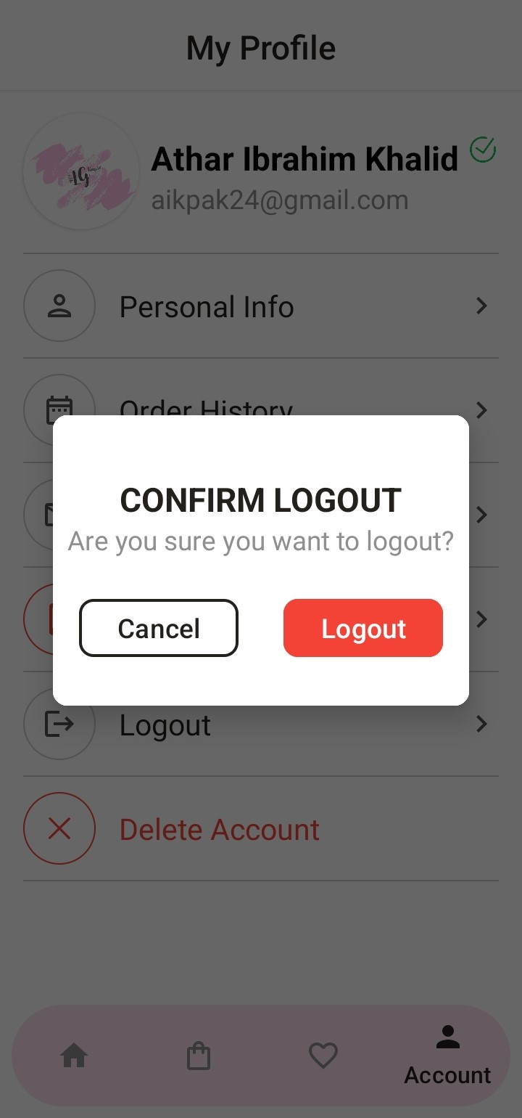
Verify Email
Verify user email by otp that display on app for 3 seconds, if user enter wrong otp then their account block for 24hours
Logout
User also logout and delete their account
Edit Profile
User edit their profile
Order History
Users see their order history on real time.
Order History
Users see their order history on real time.

Slide 30
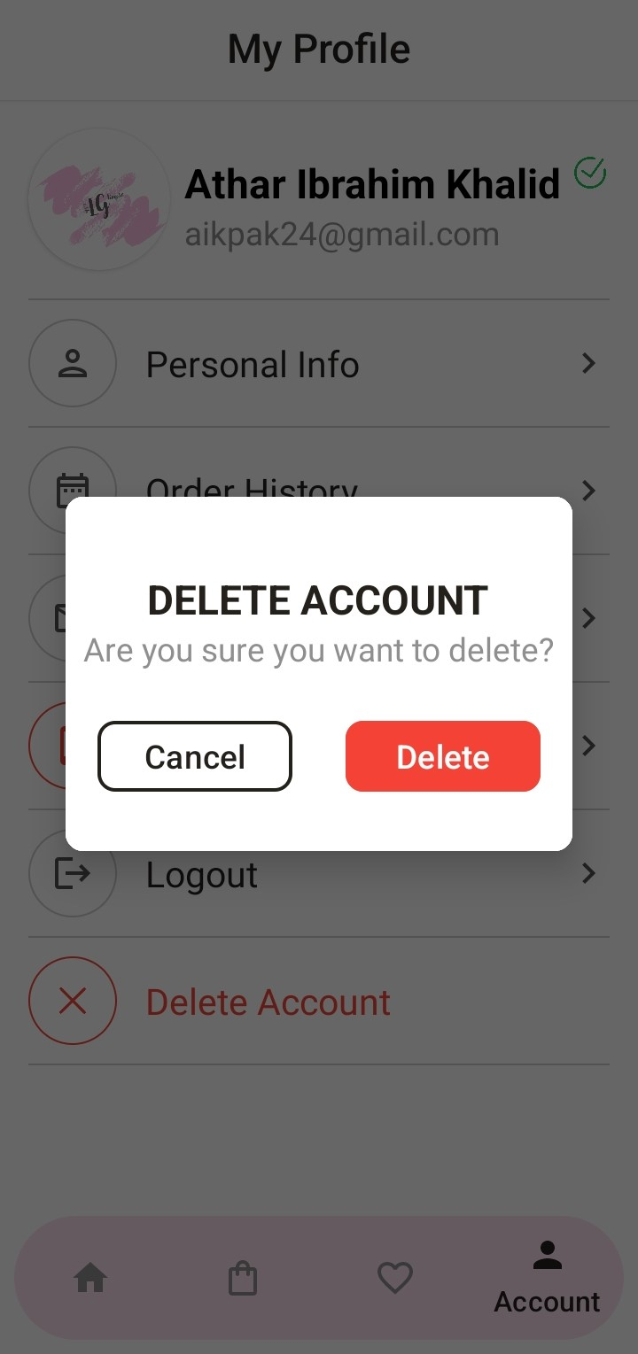
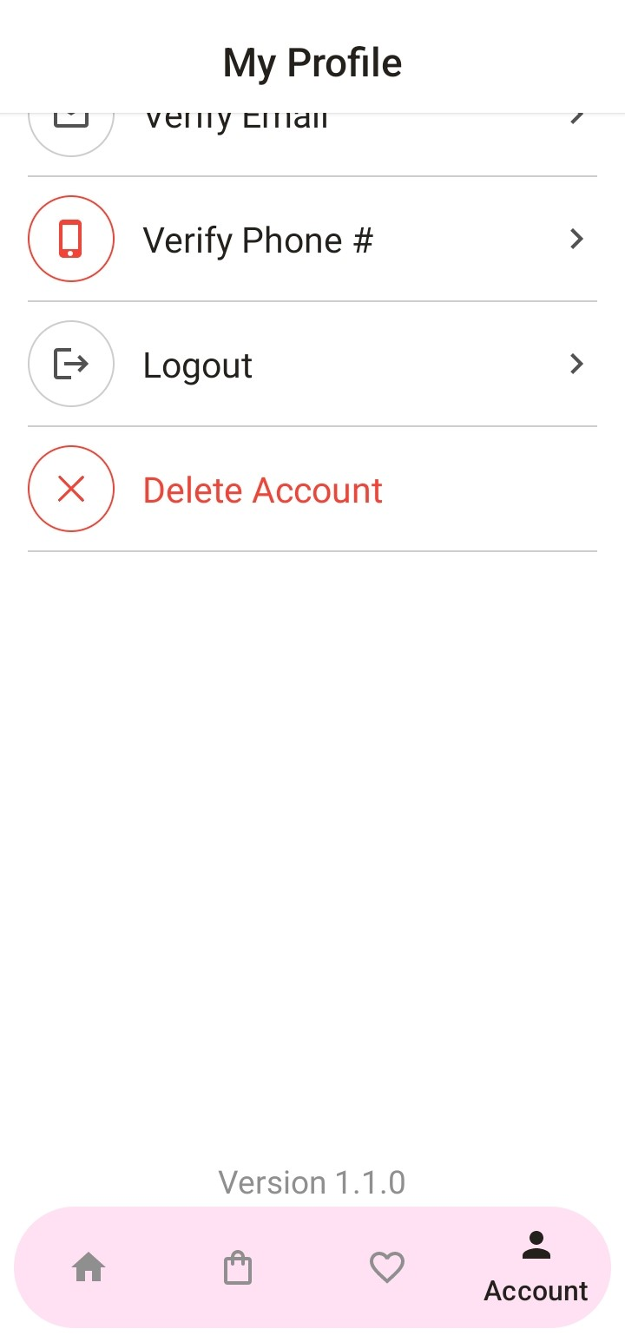
Logout
User also logout and delete their account
Edit Profile
User edit their profile
Verify Email
Verify user email by otp that display on app for 3 seconds, if user enter wrong otp then their account block for 24hours
Order History
Users see their order history on real time.
Verify Email
Verify user email

Slide 31
Logout
User alos logout their account
Edit Profile
User edit their profile
Logout
User also logout and delete their account
Order History
Users see their order history on real time.
Verify Email
Verify user email

Slide 32


Conclusion
The proposed Android e-commerce app with MySQL integration aims to meet the rising demand for efficient, secure online shopping. Utilizing MySQL, the app will ensure reliability, offline functionality, and data security for a seamless user experience. Google Authentication and analytics integration will enhance usability and value in the digital economy.

Slide 33


Thank you
@software developer
aikpak24@gmail.com

